Slide 1
PIP4004 - INTERNSHIP Final Review and Viva Presentation PRODUCT DEVELOPER INTERN AT SPARKCREW INNOVATIONS PVT LTD
Student Details
Name | MOHAMMED FAIZAN UR RAHEMAN
Roll No | 20211CCS0142
Section | 8-CCS-02
Batch No.
Under the Supervision of,
Ms.AMREEN KHANUM D
Assistant Professor
School of Computer Science and Engineering
Presidency University
Name of the Program: B.Tech Computer Science and Engineering (Cyber Security)
Name of the HoD: Dr. S P Anandraj
Name of the Program Project Coordinator: Dr. Sharmasth Vali Y
Name of the School Internship/Project Coordinators: Mr. Md Ziaur Rahman /
Dr. Sampath A K / Dr. Abdul Khadar A

Slide 2
Content
About Company or Organization
Working domain or the technology
About your team and reporting Manager
Challenges Faced in Internship
Objectives of the work
Internship Roadmap
Github Link

Slide 3
About Company
Company Name : Sparkcrew Innovations Pvt Ltd
SparkCrew is a dynamic service-based company dedicated to delivering innovative solutions tailored to meet the unique challenges of modern businesses. At SparkCrew, we specialize in providing cutting-edge technology services, seamless operational support, and customer-centric strategies designed to empower companies across diverse industries.
With a team of passionate experts, SparkCrew brings a blend of creativity, expertise, and forward-thinking approaches to help businesses achieve their goals. Our offerings span across IT consulting, process optimization, digital transformation, and custom software development, ensuring that we deliver measurable impact and sustainable growth for our clients.
At the core of SparkCrew's mission lies a commitment to excellence, collaboration, and innovation. We pride ourselves on fostering long-term partnerships by understanding the distinct needs of every client and providing tailored solutions that drive success. Whether you're looking to streamline operations, enhance your customer experience, or embrace the latest technological advancements, SparkCrew is your trusted partner in growth.

Slide 4
Sparkcrew’s Beginnings
SparkCrew started with a bold vision: to bridge the gap between businesses and transformative technology. Founded by a group of passionate problem-solvers, the company emerged from a shared belief that service-based solutions could do more than just support operations—they could inspire growth, innovation, and success.
The journey began when the founders, with diverse backgrounds in IT consulting, customer experience, and digital strategy, realized a common pain point among businesses: the lack of accessible, tailored services that addressed unique challenges. Many companies were struggling to navigate a rapidly changing digital landscape while also staying focused on their core objectives.
Recognizing this, the team set out to create a company that didn’t just deliver solutions but became a partner in every client’s success story. SparkCrew started by offering personalized IT and operational support to small businesses, but it quickly gained traction due to its hands-on approach and results-driven mindset.
As demand grew, so did the scope of SparkCrew’s expertise. From humble beginnings as a local support provider, the company has evolved into a trusted global partner, helping businesses across industries embrace the power of technology and strategic services. Guided by its founding principles of collaboration, innovation, and excellence, SparkCrew continues to spark change and drive success for every client it serves.

Slide 5
SparkCrew's Foray into EdTech
As SparkCrew expanded, the team identified a pressing need in the education sector: accessible, engaging, and customizable digital learning solutions. The pandemic highlighted this gap, inspiring SparkCrew to leverage its expertise to create a transformative EdTech product.
Their vision was to revolutionize learning by offering:
AI-powered personalized learning experiences.
Gamified, interactive content to boost engagement.
Robust tools for educators to create and track learning modules.
An intuitive, scalable platform for users of all skill levels.
Collaborating with educators and learners, SparkCrew set out to build a solution that empowers global education. By merging technology and creativity, SparkCrew aims to redefine how the world learns.

Slide 6
Working domain or the technology
Job Role : Product Development Intern
Responsibilities :
Assist in researching and analyzing emerging technologies, protocols, and tools relevant to Sparkcrew’s product development. •
Work with the technical team to brainstorm, implement, and optimize technical solutions for product challenges. •
Contribute to technical documentation, including writing user guides, FAQs, and internal reports on product development progress. •
Assist in the development and maintenance of user interfaces for Sparkcrew products and Services.
Assist in identifying and building relationships with potential partners, investors, and backers to expand Sparkcrew’s network and opportunities.
Contribute to community building and engagement strategies.

Slide 7
About your team and reporting Manager
Sparkcrew’s Tech Team is dedicated to innovating and optimizing decentralized solutions in the EdTech space. Each team member brings specialized expertise, ensuring scalable, secure, and high-performance solutions.

Slide 8
About my team and reporting Manager
Supervisor:
Mr. Abubakkar (Co-Founder & Project Manager): Spearheading Sparkcrew’s vision and business strategy, guiding product-market fit and expanding Sparkcrew’s presence. Tech Team Core Members :
1. Hrishikesh (Frontend Developer):
Specializes in designing intuitive and responsive user interfaces for SparkCrew’s products.
2. Mohammed Rayan (Backend Developer):
Expert in creating robust and scalable backend systems to support product functionality.
3. Dr. Nawaz Pasha (AI/ML Advisor):
Focuses on leveraging AI to optimize product features and enhance user engagement.

Slide 9
Challenges Faced in Internship
Understanding Tech Stack
Team Communication
Imposter Syndrome & Adjusting to Fast Paced Work Environment

Slide 10
Objectives of the work
Conduct market research to understand trends and user needs.
Assist in brainstorming and creating product roadmaps.
3.Design prototypes and support usability testing.
Collaborate with cross-functional teams to meet project timelines.
Maintain documentation of product specs and testing results.
Stay updated on trends and propose product improvements.
Analyze post-launch performance and suggest improvements.

Slide 11
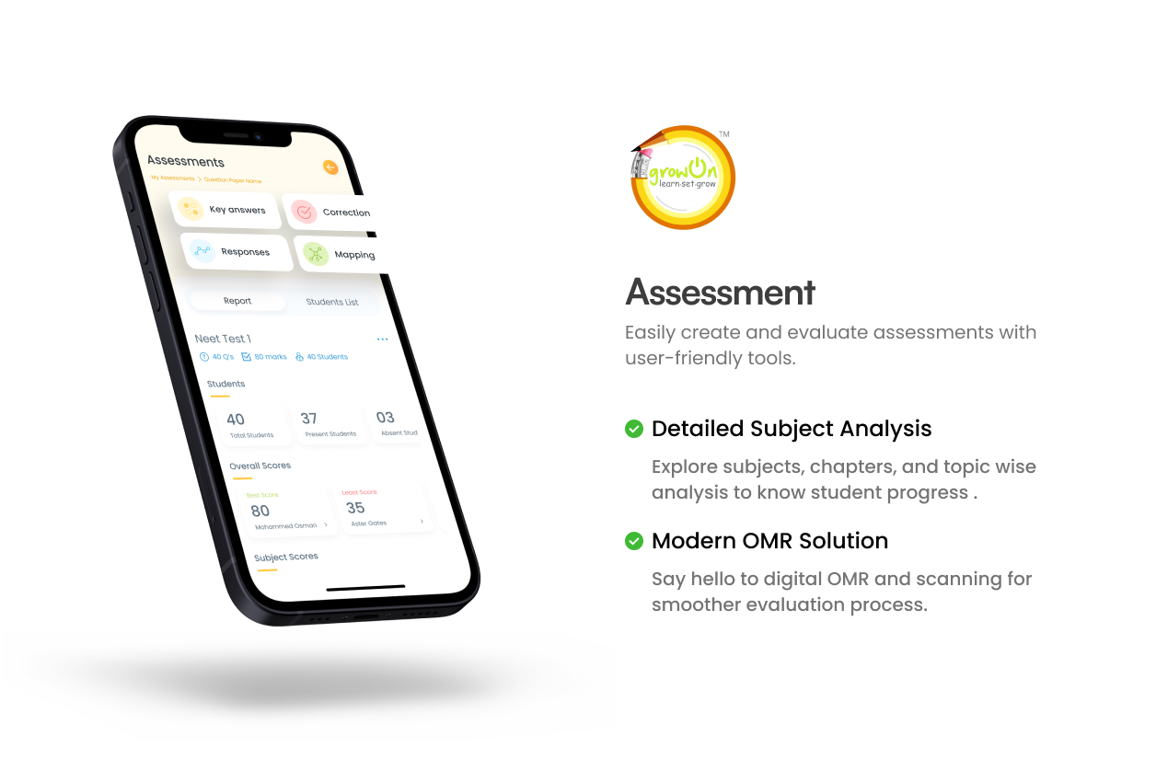
Snapshots of the Work done

Slide 12
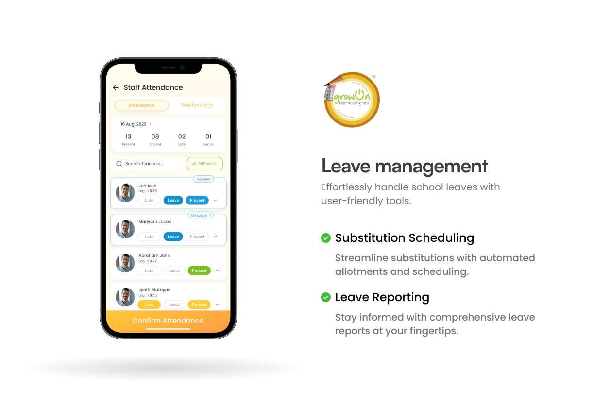
Snapshots of the Work done

Slide 13

Snapshots of the Work done

Slide 14
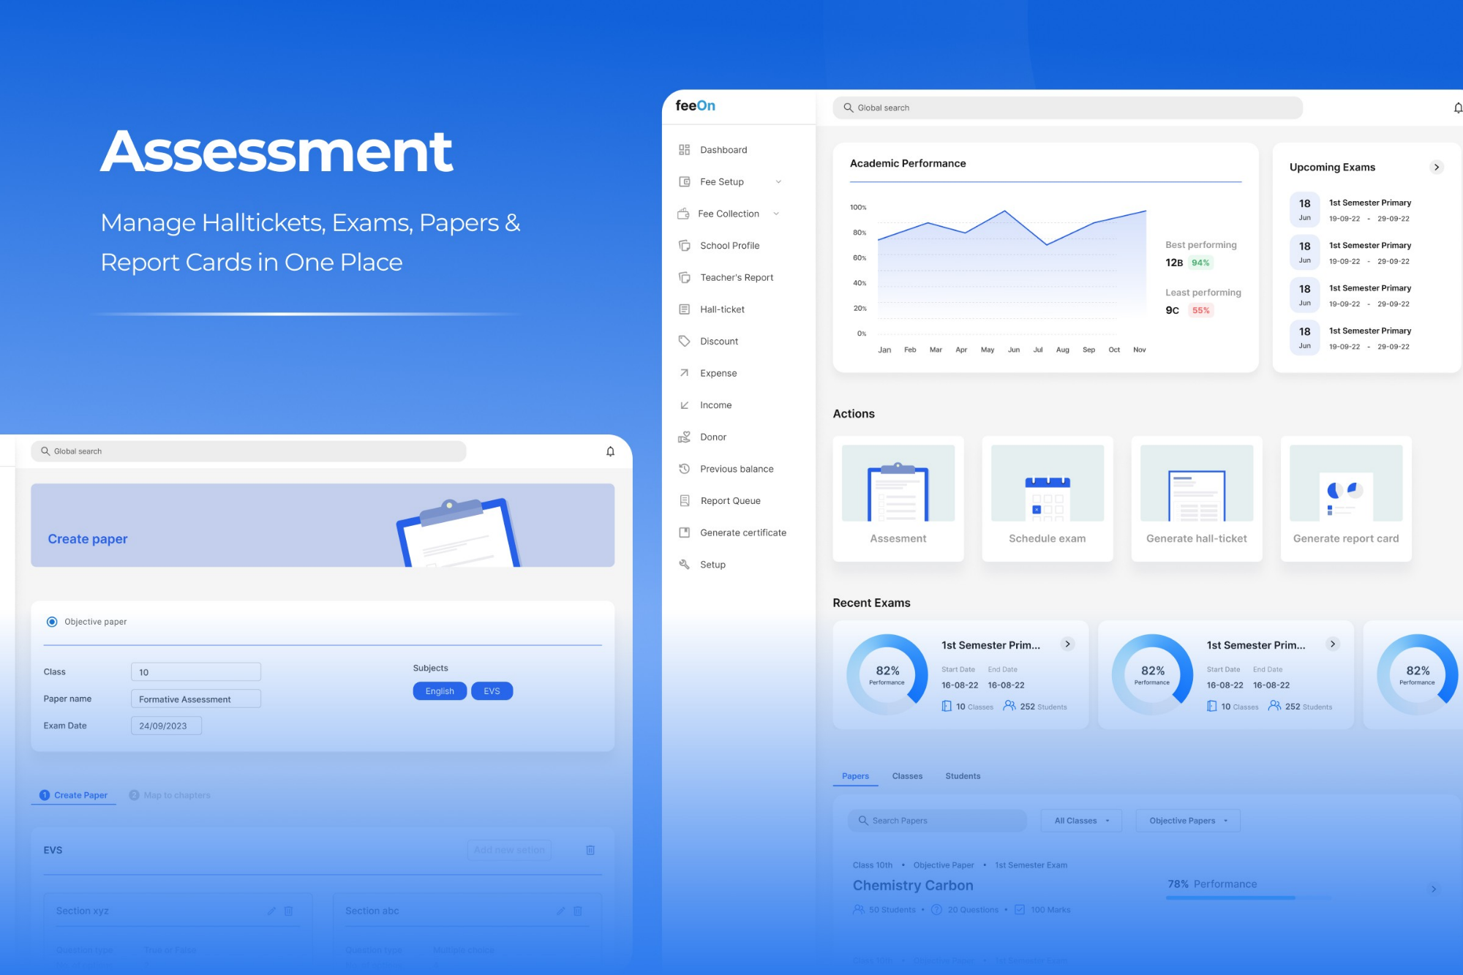
Snapshots of the Work done

Slide 15
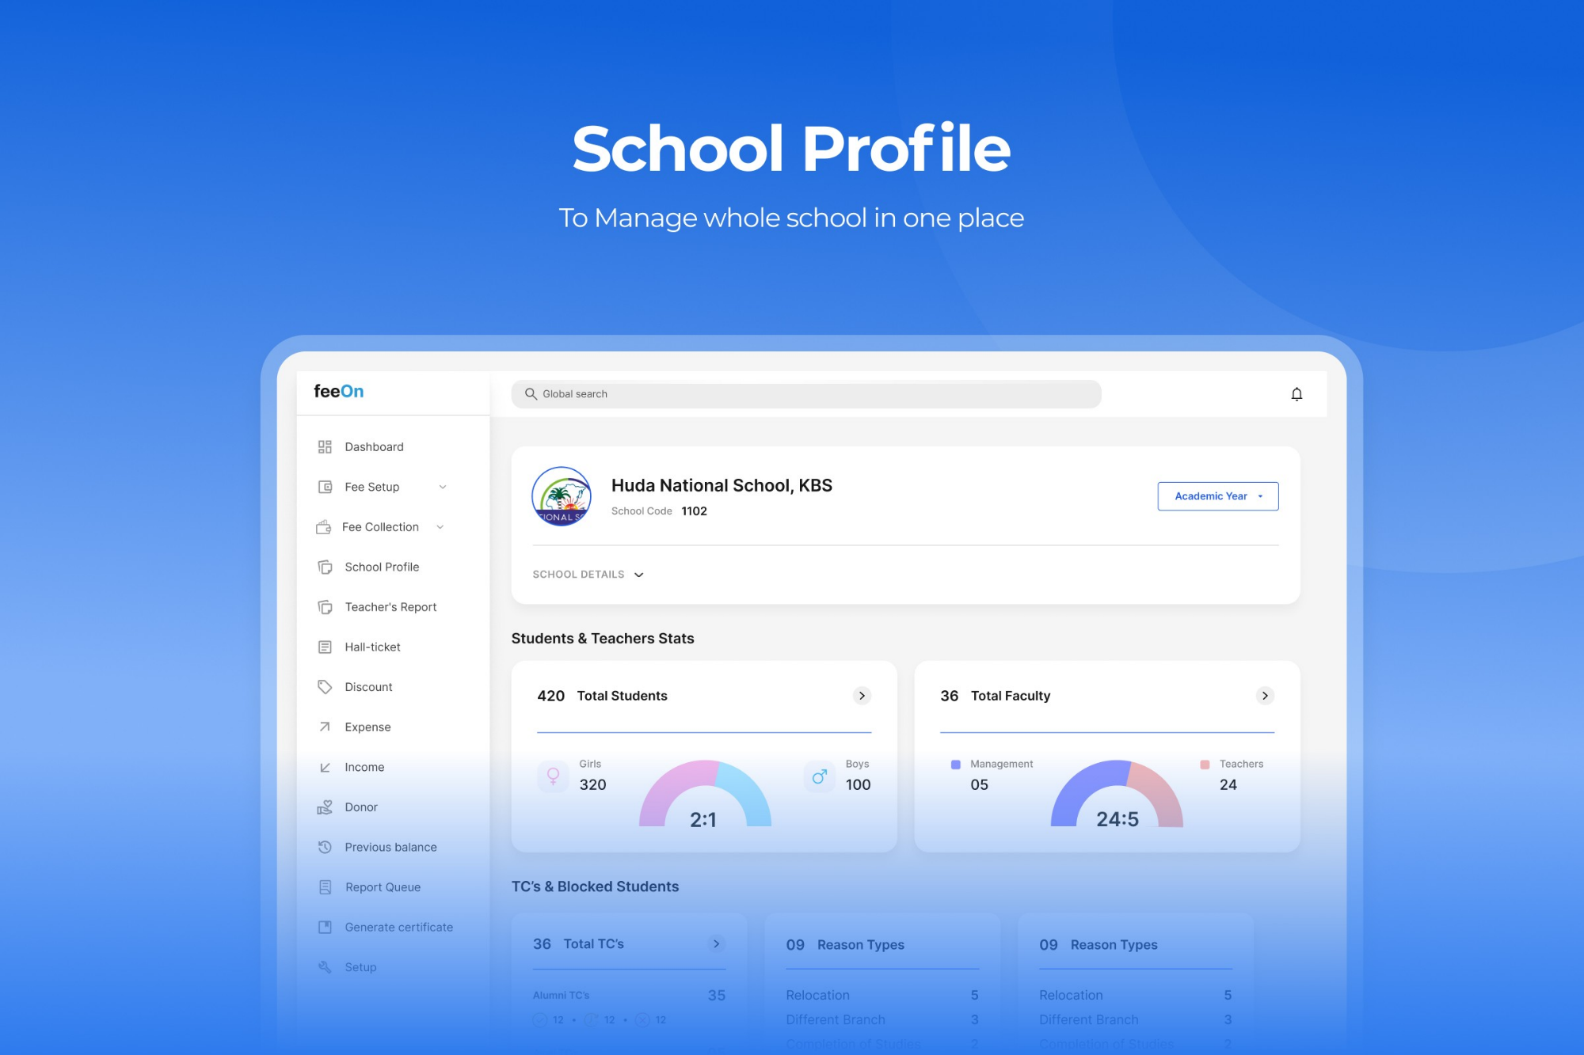
Snapshots of the Work done

Slide 16
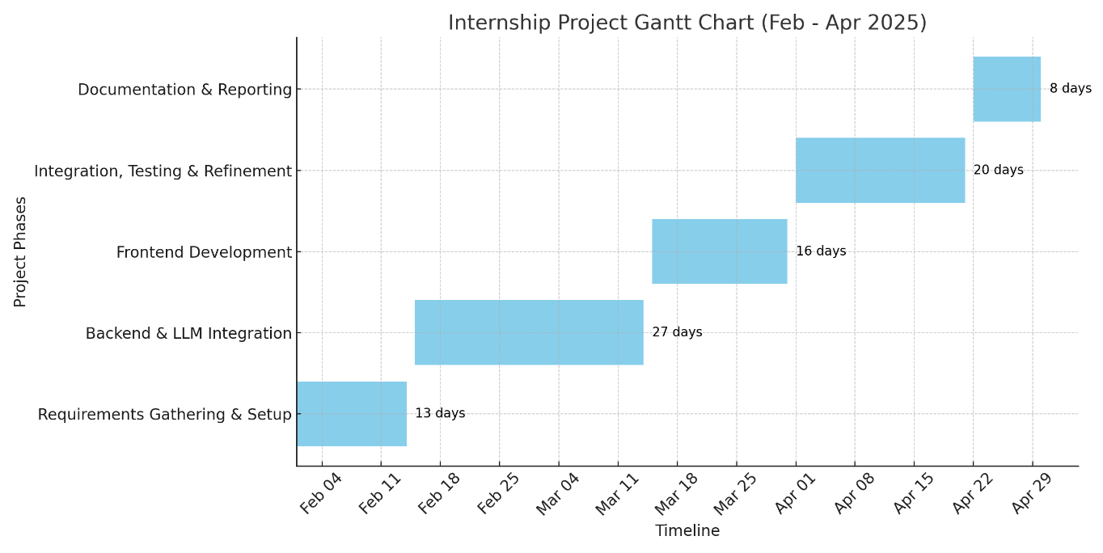
Internship Road Map

Slide 17
Github Link https://github.com/Mohammedccs0142/Internship-2025

Slide 18
Q&A

Slide 19
Thank you !!

